Slide 1


Slide 2
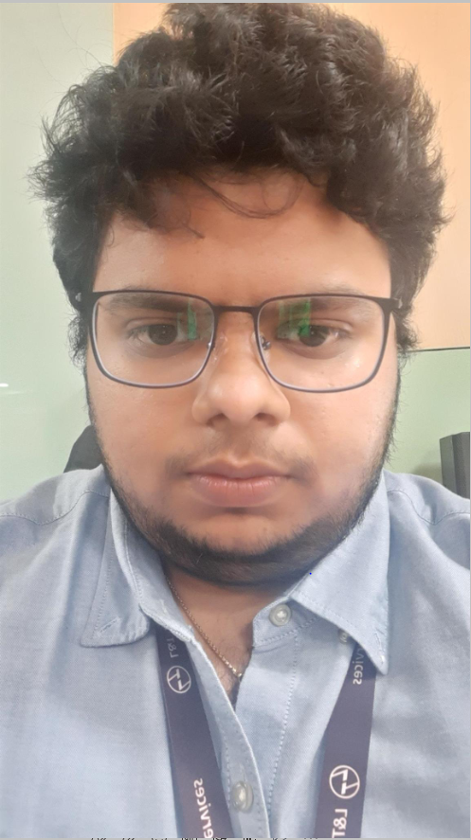
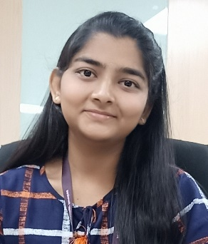
Project Highlights
Project Name : Manual and Automation testing of mobile applications for both Android and iOS
Team Size : 2
BU Mentor Name : Sagar.K Mentor PS# 40010755
M V N S K Aditya
99002471
MYSEMB03
Shandhiya V.S
99002477
MYSEMB03

Slide 3
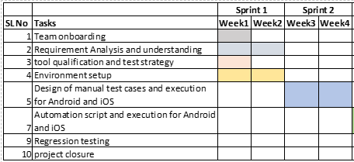
Project Plan

Slide 4
Project Status, Key Updates and Attention areas
Current Stage of the project: | Installed Appium, Android studio , Eclipse IDE ,Installed Cucumber and used Selenium for doing the login operation according to the test plan
Overall project progress: | On time
Key Updates
Week 1 : Raised ticket to install the software Understanding the concepts of automation and wrote manual test cases Week 2 : Going through the materials and links for understanding automation framework Understanding Appium. . Week 3: 1. Understanding cucumber and feature files. 2.Automation of an app using BDD by using cucumber ,Appium and Selenium
Attention areas
Learning Serenity Framework to automate an app
Plan for next week
. Automate the app using the Serenity framework

Slide 5
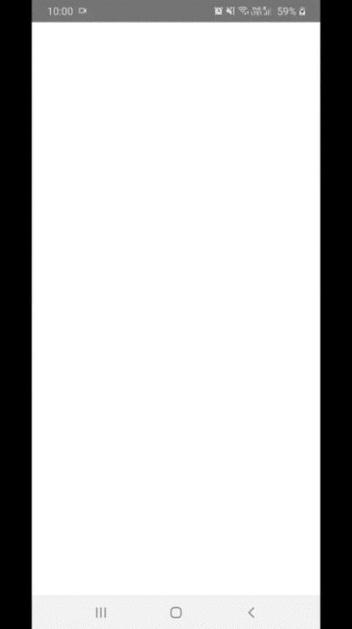
Project Video Snippet

Slide 6
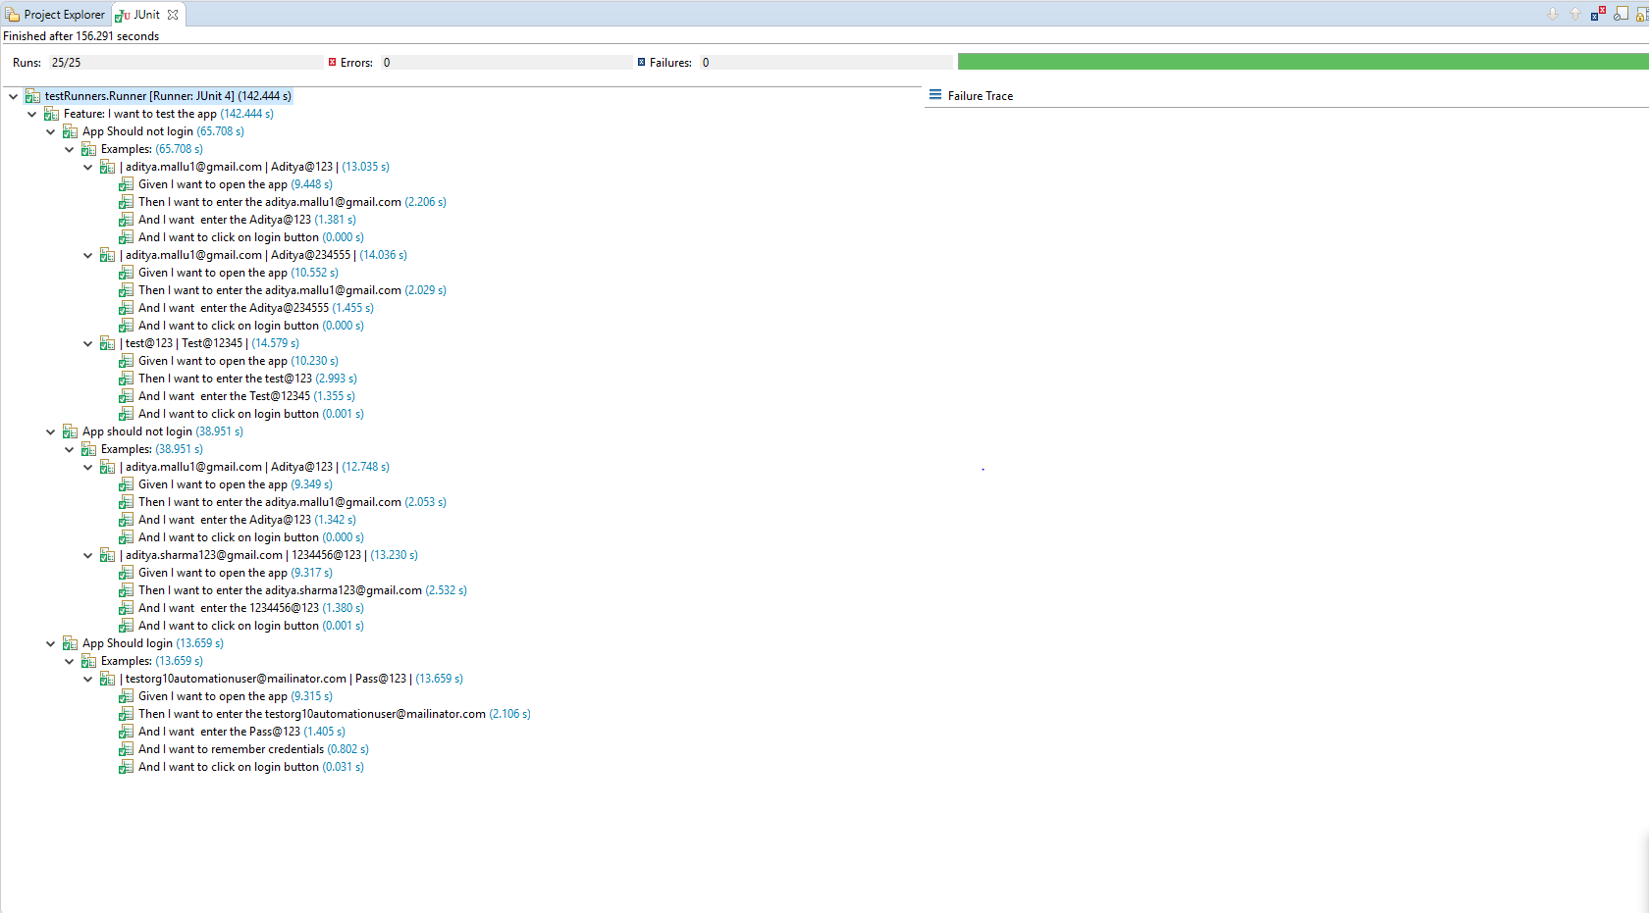
Project Test Cases Report

Slide 7


Thank You !

